Slide 1

Non-Fungible Tokens (NFTs)
Rabin Thapa

Slide 2
Outline
Motivation
Introduction to NFTs
How NFTs work?
Standards
How are they created and “stored”?
How are they traded?
Protection against attackers
Applications of NFTs
Concerns related to NFTs

Slide 3
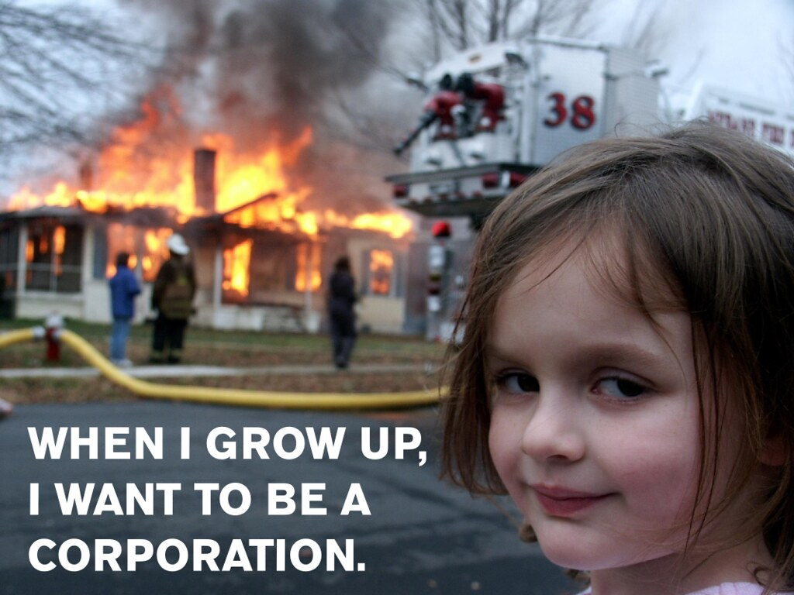
Motivation
One of the latest applications of Blockchain
Sale of NFTs exploded from $12m (Dec 2020) to 340m (Feb 2021)
Recent major transactions:
“Disaster Girl” NFT sold for 180.00 ETH
Jack Dorsey sold the first ever tweet for $2.9m
Beeple sold “Everydays: The First 5000 Days” for $69m
Cryptokitties (since 2017)
A “Disaster Girl” meme (Occupy* Posters, 2012); the photo’s NFT sold for over $430k

Slide 4
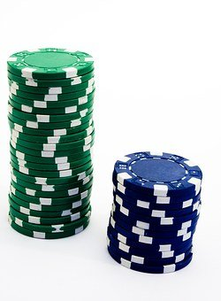
Tokenization
Substituting a meaningful piece of data by a random string of characters called token
Tokens
have no extrinsic or exploitable meaning
Linked to the actual asset
Example: Casino tokens
Encryption | Tokenization
converts plaintext into ciphertext using encryption algorithm and key | non-mathematical approach in which data is replaced by token of same length and type as the data

Slide 5
Fungibility
“Ability of a good or asset to be interchanged with individual good or asset of same type” (Investopedia,n.d.)
Fungible: can be traded with another of same kind
a dollar bill
Bitcoin
Non-fungible example: one-of a kind
owned cars or pets
autographed books

Slide 6
Non-fungible tokens
Blockchain-based virtual assets (token)
Not inherently interchangeable with other digital assets (non-fungible)
Can represent
Physical property — houses, unique artwork
Virtual collectables — unique pictures of kittens, collectable cards
“Negative value” assets — loans, burdens and other responsibilities
Can be
Created, owned, sold, destroyed in blockchain

Slide 7
Standards
Standards differ with blockchain
Ethereum (ERC-721 built on Solidity)
Smart contracts
In 1994 Nick Szabo, defined smart contracts as "a computerized transaction protocol that executes the terms of a contract"
ERC-721
Acts as blueprint for NFTs
Contains methods to interact with NFT
Emits events and writes logs

Slide 8
ERC-721: a concise view
contract ERC721 {
// Methods
function ownerOf(uint256 _tokenId) external view returns (address);
function balanceOf(address _owner) external view returns (uint256);
function safeTransferFrom(address _from, address _to, uint256 _tokenId) external payable;
. . .
// Events
event Transfer(address indexed _from, address indexed _to, uint256 indexed _tokenId);
event Approval(address indexed _owner, address indexed _approved, uint256 indexed _tokenId);
. . .
}

Slide 9
How do NFTs work?
NFT Identifiers
(contract address, uint256 tokenID)
Metadata: name and symbol
Transfer Mechanism
Functions: transferFrom and safeTransferFrom
Permissions:
Approved address
Owner, Authorized operator
Privacy
Anybody can call ownerOf for every tokenID
Pseudonymity

Slide 10
How do NFTs work? (cont.)
Owners can:
easily prove ownership
Sell it
In NFT market or peer-to-peer
No intermediaries
Creators can:
prove they created it
determine scarcity
Sell it:
Earn royalty every time it is sold (e.g. EulerBeats Originals)
Private key (256 bits)
Elliptic-curve
Encryption
One-way
Public key (512 bits + a prefix)
Cryptographic hashing
One-way
Address (160 bits)

Slide 11
Security of Ownership
NFTs linked to their owner’s wallet
Ownership history “immortalized” in blockchain
51% attack – rare
need valid signature (256-bit) to manipulate NFT
How secure is a 256-bit key?
Energy needed to flip a bit: 4.4*10⁻¹⁶ erg
Annual output of the sun: 1.21*10⁴¹ erg
1 Sun ≡ 2.7*10⁵⁷ bit changes ≡ 187-bit values
256-bit key ≡ 2⁶⁹ suns in a year

Slide 12
“Minting” NFTs
When an NFT is minted/traded,
The transaction is added to a new block
Owner’s account balance is updated
The block is confirmed as “correct” by miners in the network
How to mint?
Wallet
Some gas
Supports ERC-721
NFT-centric Platform
(OpenSea)
NFT
Data file
(.png, .mp4, …)

Slide 13
Applications
Digital art and Collectibles
Gaming
Tokenizing game elements or items
Sports
Tokenized ticketing system
Monetizing iconic moments
Music
Artists who created NFTs: Kings of Leon, Grimes
Virtual worlds
Create, own, and trade virtual land and other elements

Slide 14
NFT-related issues
Skepticism
Are they really as rare as they are meant to be?
Does the “owner” of an NFT really “own” an object?
It’s not gold!
Legal concerns
Regulations differ with countries
Interoperability
Environmental concerns
Blockchain are energy intensive

Slide 15
Conclusion
One-of-a-kind virtual asset
Immutable, Programmable
Secured ownership, and trade without intermediaries
Price determined by what they represent
Applications in many fields
Yet to be mainstreamed

Slide 16
References
Bitcoin Private Keys, Public Keys, and Addresses: The Basics - BC. (2020, May 16). Bitcoin Clarity. https://getbitcoinclarity.com/blog/2020/05/16/what-is-a-bitcoin-private-key
Boscovic, D. (2021, March 31). How nonfungible tokens work and where they get their value – a cryptocurrency expert explains NFTs. The Conversation. https://theconversation.com/how-nonfungible-tokens-work-and-where-they-get-their-value-a-cryptocurrency-expert-explains-nfts-157489
Chevet, S. C. (2018, August). lockchain Technology and NonFungible Tokens: Reshaping value chains in creative industries (Master’s). https://papers.ssrn.com/sol3/papers.cfm?abstract_id=3212662
Chohan, U. W. C. (2021, April 21). Non-Fungible Tokens: Blockchains, Scarcity, and Value. Critical Blockchain Research Initiative (CBRI) Working Papers. https://papers.ssrn.com/sol3/papers.cfm?abstract_id=3822743
Crypto Casey. (2020, November 26). What are NFT’s in Crypto? (Non-Fungible Tokens!) - Beginner’s Guide [Video]. YouTube. https://www.youtube.com/watch?v=H-bX2eR4Yvs
Occupy* Posters. (2012). Disaster Girl Wants to Be a Corporation [Meme]. Flickr. https://www.flickr.com/photos/owsposters/6833714935
Ethereum. (n.d.-a). ERC-721 Non-Fungible Token Standard. Ethereum.Org. Retrieved April 2021, from https://ethereum.org/en/developers/docs/standards/tokens/erc-721/
Ethereum. (n.d.-b). Non-fungible tokens (NFT). ethereum.org. Retrieved April 2021, from https://ethereum.org/de/nft/

Slide 17
References (cont.)
Fermat’s Library. (2018, March 3). Fermat’s Library on [Tweet]. Twitter. https://twitter.com/fermatslibrary/status/969935429712666625/photo/1
Fungibility: When Interchangeability Matters. (n.d.). Investopedia. https://www.investopedia.com/terms/f/fungibility.asp#
Leech, O. (2021, April 27). NFTs: How to Create, Buy and Sell Them. CoinDesk. https://www.coindesk.com/how-to-create-buy-sell-nfts
Musan, D. I. M. (2020, June). NFT.finance Leveraging Non-Fungible Tokens (Thesis). https://www.imperial.ac.uk/media/imperial-college/faculty-of-engineering/computing/public/1920-ug-projects/distinguished-projects/NFT.-finance-Leveraging-Non-Fungible-Tokens.pdf
Nash, G. (2018, June 21). The Anatomy of ERC721 - Crypto Currently. Medium. https://medium.com/crypto-currently/the-anatomy-of-erc721-e9db77abfc24
Non-fungible token. (2021, April 21). In Wikipedia. https://en.wikipedia.org/wiki/Non-fungible_token
Orcutt, M. (2020, April 2). How secure is blockchain really? MIT Technology Review. https://www.technologyreview.com/2018/04/25/143246/how-secure-is-blockchain-really/
Tokenization (data security). (2021, April 2). In Wikipedia. https://en.wikipedia.org/wiki/Tokenization_(data_security)
What is Tokenization vs Encryption - Benefits Uses Cases Explained | McAfee. (n.d.). McAfee. Retrieved April 27, 2021, from https://www.mcafee.com/enterprise/en-us/security-awareness/cloud/tokenization-vs-encryption.html

